Slide 1


Republic of Senegal
Minister of Higher Education, Research and Innovation
Unit of Training and Research in Engineering Sciences
Department: Civil Engineering
SECTOR: Geomatics
Theme: Surveying Methods and Tools
Exhibitors:
Mouhamadou Fadel Fall
Marie Simone Djiboune
Aicha Ndiaye
Under the supervision of the professor:
MRS BARRY

Slide 2
Plan
Introduction
Surveying methods
Traditional surveying
Modern surveying
Surveying tools
Surveying application
Challenges and limits of surveying
Conclusion

Slide 3
INTRODUCTION
Surveying is an essential technique used in construction, mapping, and land development. Surveying plays a key role in many industries, helping engineers, architects, and planners create safe and efficient structures. In this presentation, we will explore different surveying methods, tools, and their applications in the modern world.

Slide 4
SURVEYING METHODS
Surveying uses different methods to measure and map land accurately. These methods are divided into traditional and modern techniques.

Slide 5
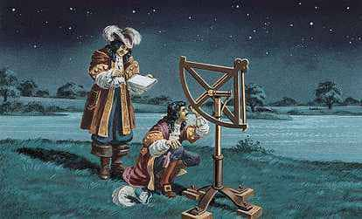
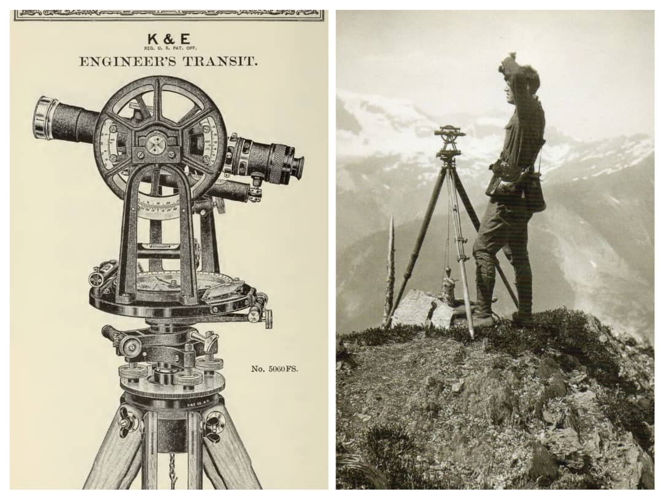
Traditional Methods
Triangulation: This method involves measuring angles in a network of triangles to calculate distances between points.
Traversing (Polygon Method): This method connects several points to measure distances and angles along a set path.
Leveling: Used to measure the differences in height between points on the land.

Slide 6
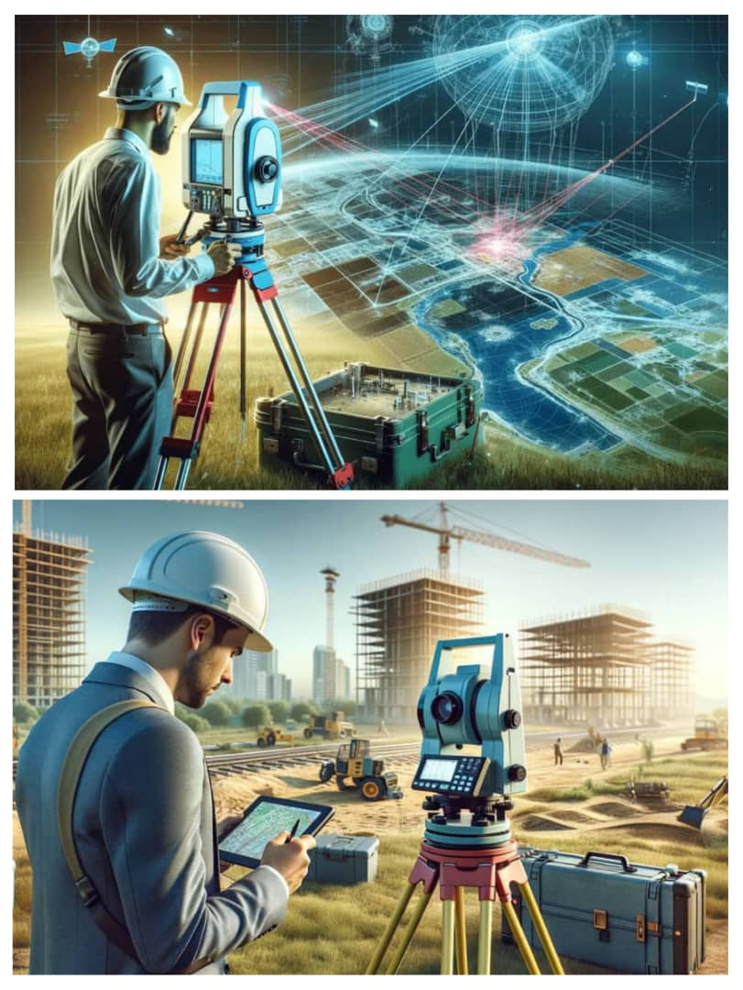
Modern Methods:
GPS (Global Positioning System): Uses satellites to provide precise location coordinates, making surveying faster and more efficient.
Remote Sensing (Drones, Satellites): Captures aerial images to map large areas accurately.
Lidar (Light Detection and Ranging): Uses laser beams to create detailed 3D models of the land.
These advancements have made surveying more accurate, faster, and accessible, helping in construction, urban planning, and environmental management.

Slide 7
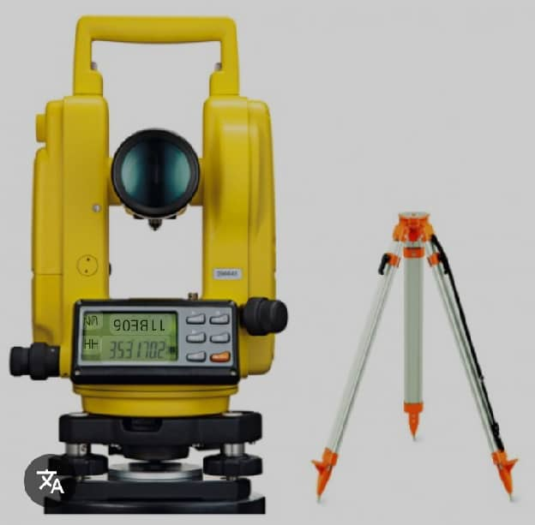
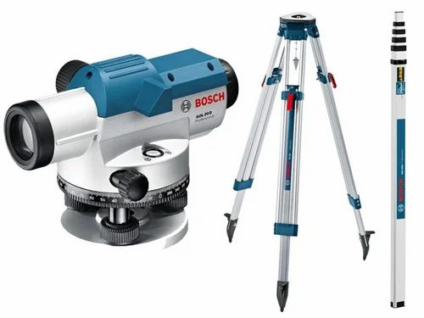
SURVEYING TOOLS
Surveying tools are essential for making accurate measurements on the ground. Here are some of the main instruments used by surveyors:
The Theodolite: This instrument measures horizontal and vertical angles, which are crucial for determining directions and positions of points on the land.
Optical Level: Used to measure height differences between two points, important for establishing levels and slopes

Slide 8
Total Station: A more modern tool that combines the measurement of distances and angles electronically, allowing for faster and more accurate surveys.
Differential GPS: A positioning system that uses satellites to obtain extremely precise coordinates, often used for large-scale surveys.

Slide 9
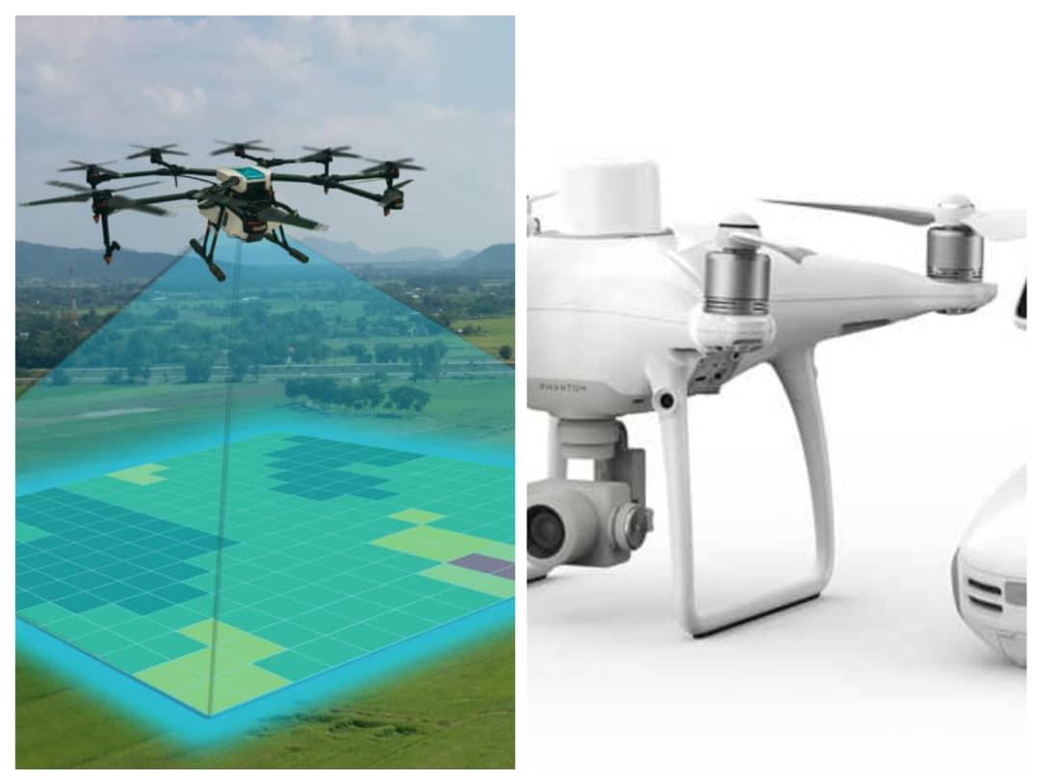
Drones and Lidar: Drones equipped with Lidar sensors allow for creating detailed 3D maps and models of the terrain, reducing work time and increasing accuracy.
These tools, combined with modern technology, make surveying faster, more precise, and more accessible.

Slide 10
APPLICATION OF SURVEYING
Construction and Urban Planning: Photo of a construction site with surveyors at work, or a city planning model.
Mapping and Geodesy: Image of topographic maps or digital maps created by surveyors.
Precision Agriculture: Photo of a farmer using surveying technology or a digital map to manage crops.
Infrastructure Management: Image of a bridge or road with surveyors inspecting existing infrastructure.
Environmental Protection: Image of a natural area, like a forest or mountain, being monitored by surveyors or a drone.

Slide 11
CHALLENGES AND LIMITS OF SURVEYING
Surveying Is essential for land management but comes with challenges and limitation:
Challenges in Surveying:
Data Accuracy and Reliability: Inaccurate measurements can lead to property disputes, construction errors, and economic losses.
Technological Advancements: Integrating new technologies like GPS and Lidar requires continuous professional development to maintain service quality.
Environmental Impact: Surveying activities should minimize ecological disturbances, especially when using drones or altering sensitive terrains.
Cost and Accessibility: Surveying services can be expensive, potentially limiting access for certain property owners or budget-constrained projects.

Slide 12
Limitations of Surveying:
Legal and Regulatory Constraints: Diverse laws and regulations across regions can complicate cross-border or interprovincial projects.
Geographical and Climatic Conditions: Difficult terrains and extreme weather can hinder accurate measurements and data collection.
Data Interpretation: Survey data requires careful analysis; misinterpretations can affect decisions based on this information.
Natural Changes: Natural events like erosion or tectonic movements can alter physical markers, rendering previous measurements obsolete.
In summary, while surveying is crucial for effective land management, recognizing and addressing its challenges and limitations is essential for accurate and reliable outcomes.

Slide 13
CONCLUSION
Land surveying, vital for planning, land boundaries, and resource management, combines tools (theodolites/drones/LiDAR) for precision and environmental protection. Technological/legal challenges demand a sustainable approach.
Sources:
Chat GPT/ Deep Seek
GOOGLE

